Slide 1
Microservices
Spring Boot

Slide 2
Content
Definition
Features
Architecture

Slide 3
Definition
Microservice is a variant of the service-oriented architecture (SOA) where the application is arranged as a collection of loosely-coupled services.

Slide 4
Features
Loosely coupled
Services are fine-grained
Protocols are lightweight
Independent development
Fast deploy

Slide 5
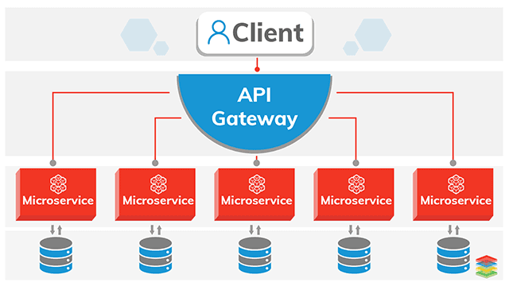
Architecture

Slide 6
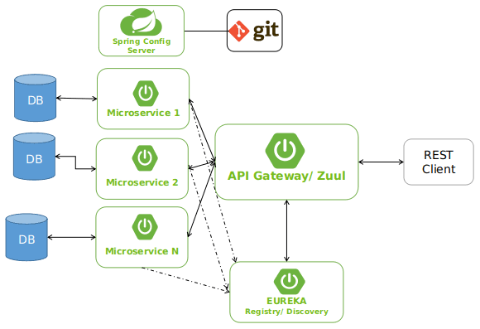
Microservice and Spring

Slide 7
Spring Config Server
The Spring Cloud Config provides a central place to externalize and manage configurations in a distributed system.

Slide 8
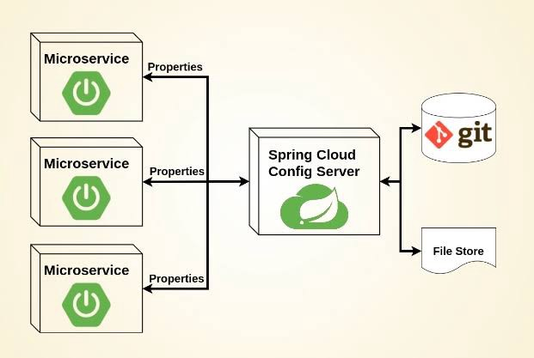
Spring Config Server

Slide 9
Spring Cloud Gateway
The Spring Cloud Gateway provide a way for building an API Gateway in a distributed system.

Slide 10
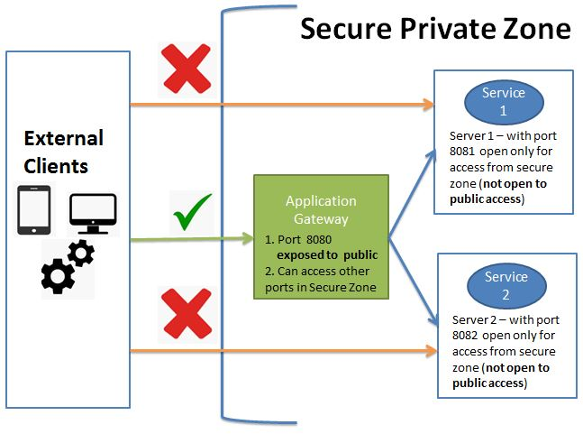
Spring Cloud Gateway

Slide 11
Spring Cloud Netflix - Eureka
The Spring Cloud Netflix Eureka is a server that holds the information about all services in a distributed system.

Slide 12
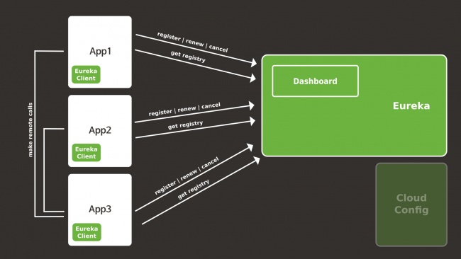
Spring Cloud Netflix - Eureka

Slide 13
References
https://en.wikipedia.org/wiki/Microservices
https://microservices.io/
https://spring.io/projects/spring-cloud-config
https://spring.io/projects/spring-cloud-gateway
https://spring.io/projects/spring-cloud-netflix

